Slide 1
Investigating Chewy.com’s Dry Dog Food Prices
Thinkful
Data Science Immersion: Cohort 4
Capstone 1
Emily Manne-nicholas

Slide 2
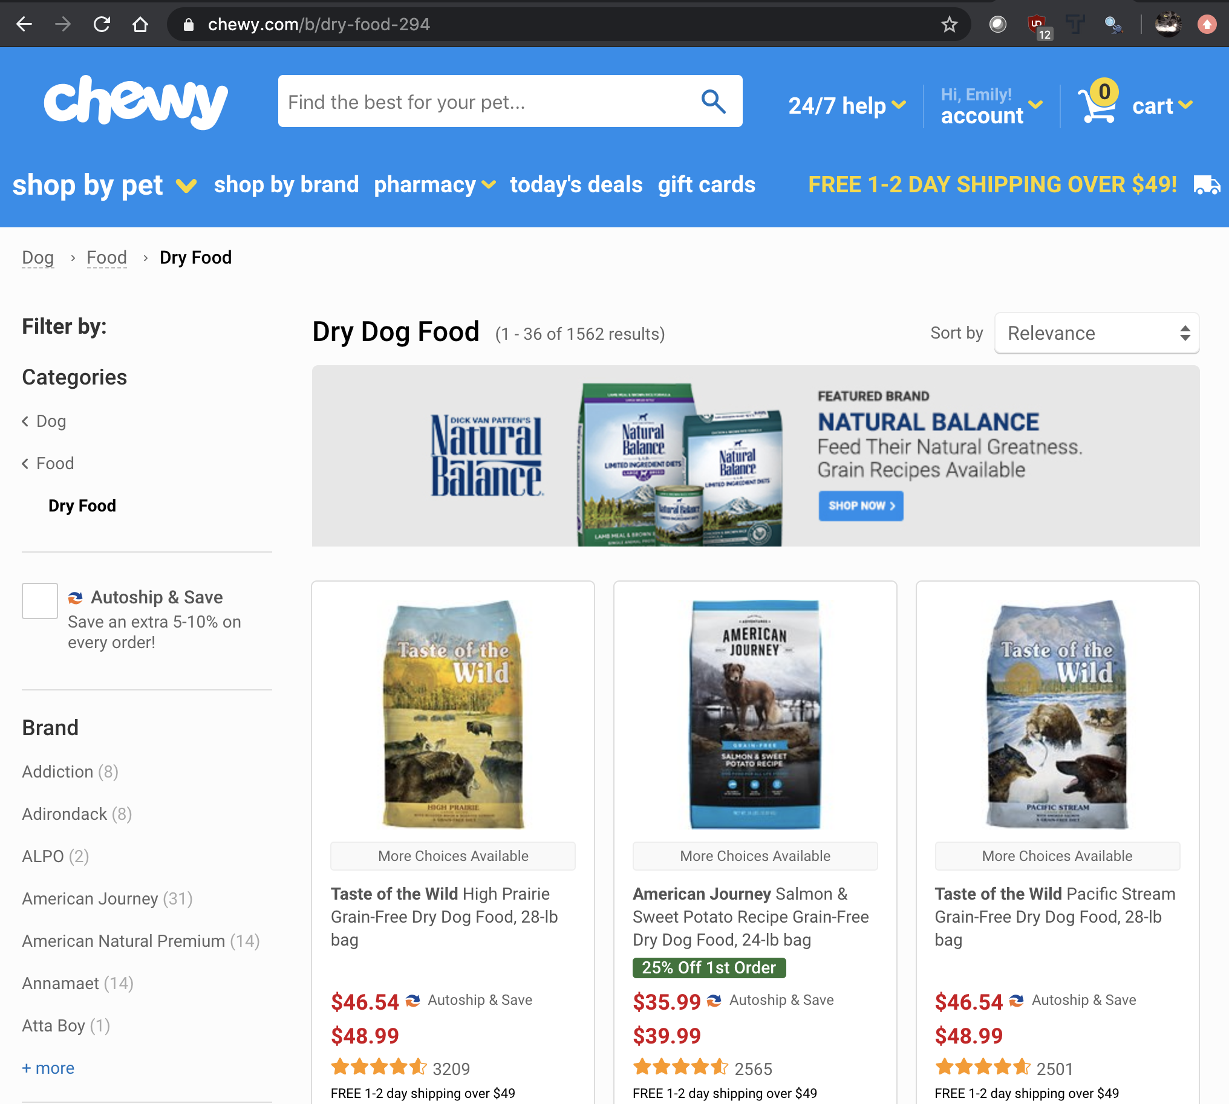
What is Chewy.com?
US’s largest pet supplies e-tailer
Publicly traded subsidiary of PetSmart
100 million orders since its creation in 2011.
1,000 brands, and over 1,500 different dry dog foods.
Notes:
Stock price has gone up amidst pandemic. Hiring 400 workers to keep up with surge in demand.

Slide 3

Why dog food?
I’ve sold countless bags of dog food
Sales reps may give info that is based on marketing strategy
Customers often puzzled at price points
What drives price differences?
Notes:
Info could be useful for chewy.com customers (I am one, personally). Could also be useful for pet food sellers (I was one) who want to be educated about their products in order to see through the marketing and help pet owners understand what they’re paying for.

Slide 4
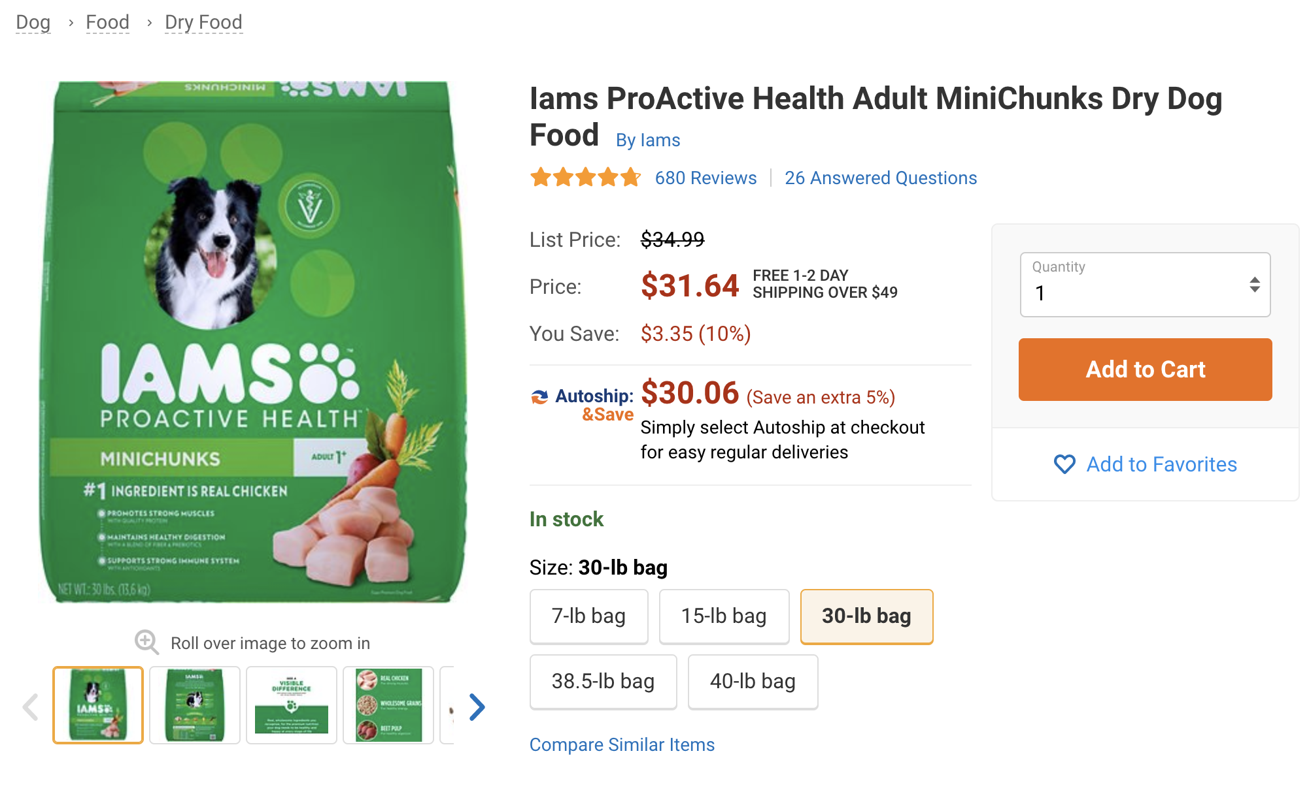

Slide 5
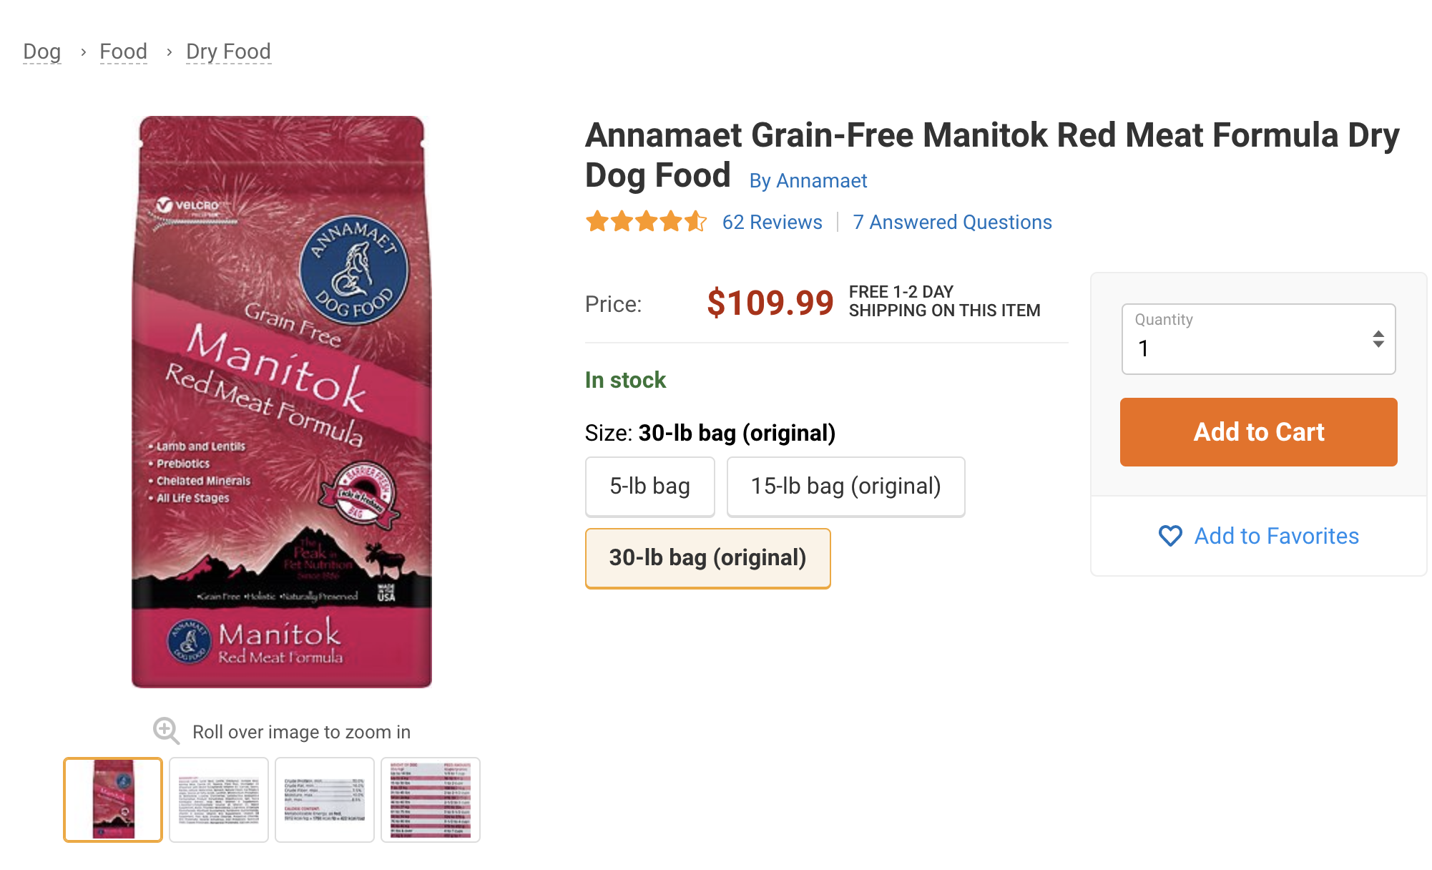

Slide 6
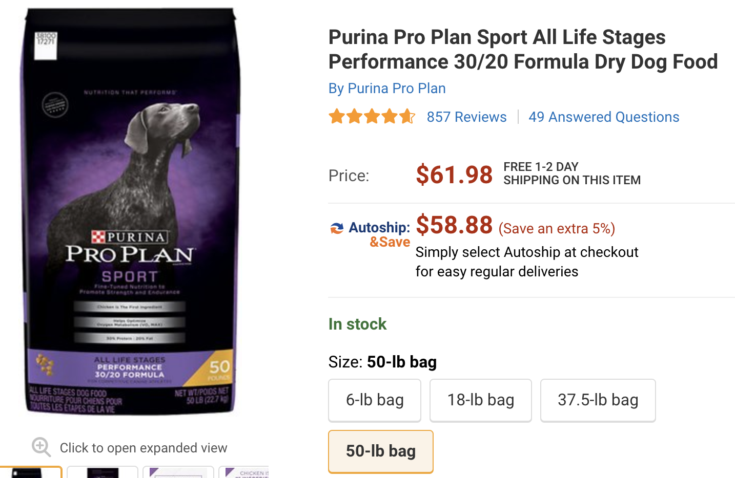

Slide 7
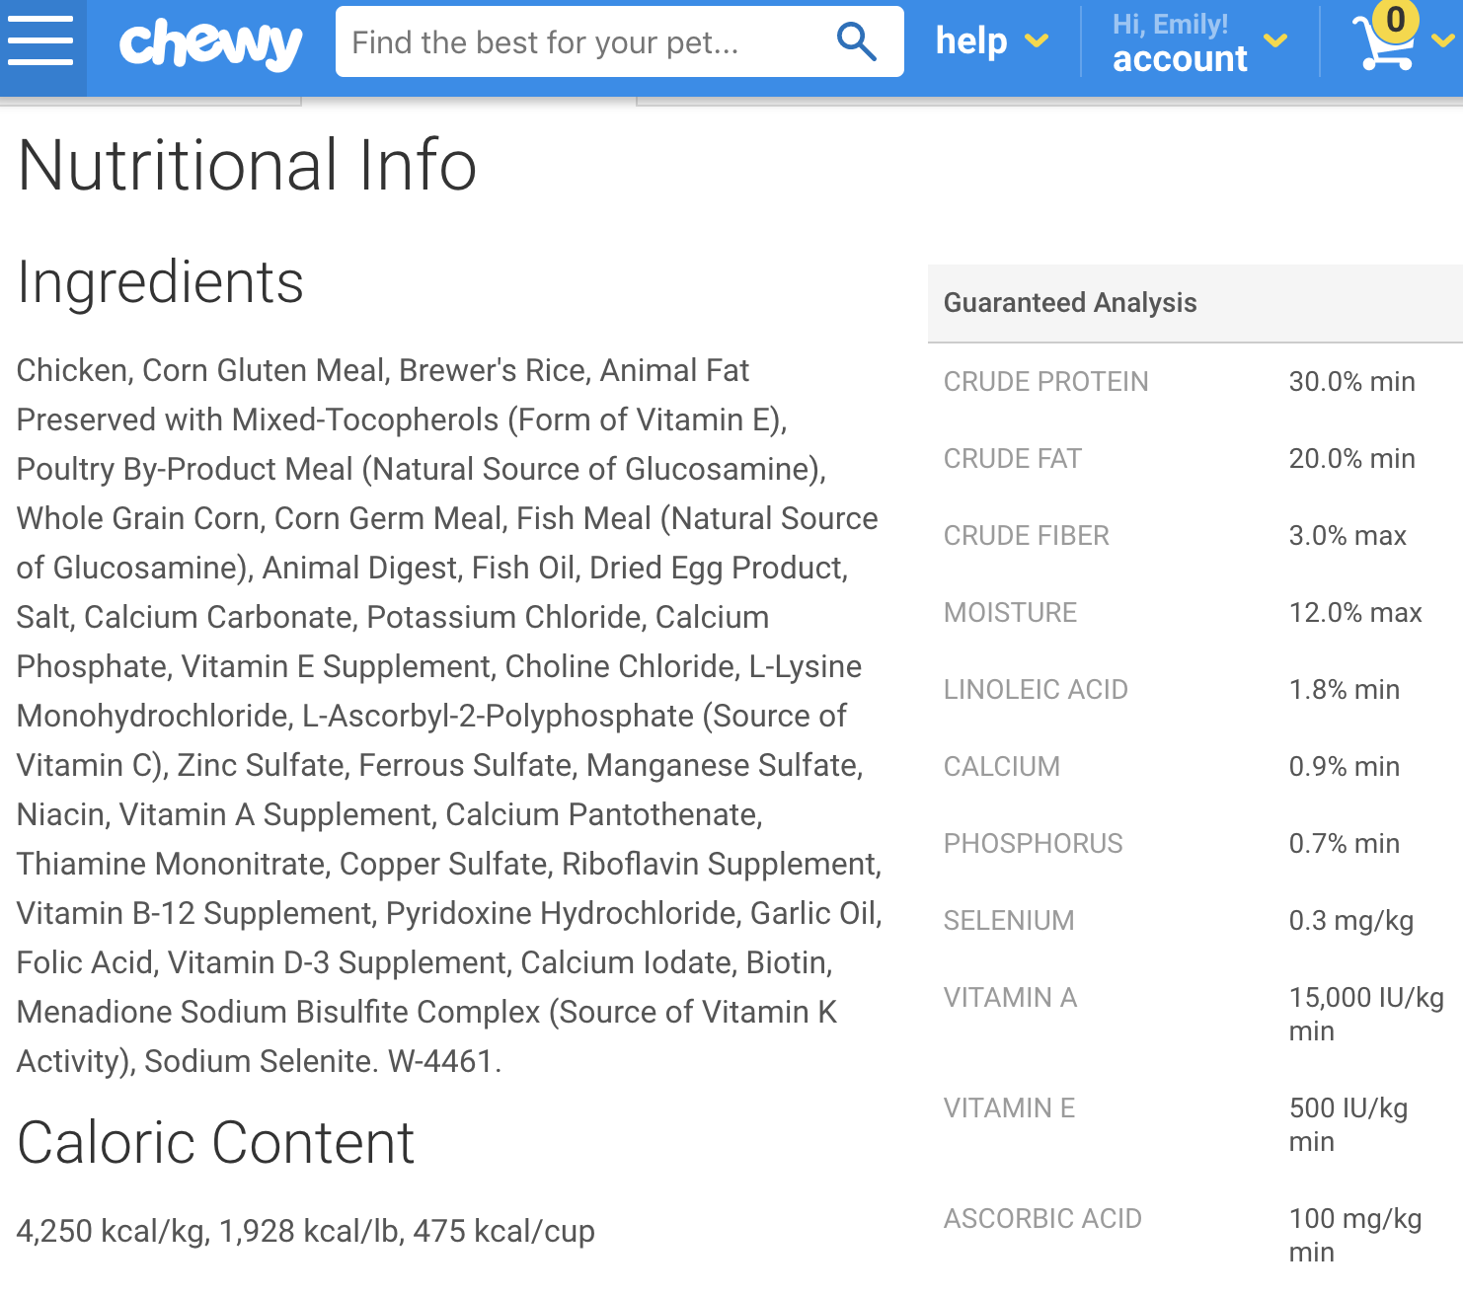

Slide 8
The Sample
580 unique bags of dog food in sample
Variables to test:
Crude Protein (%)
Chewy.com average reviewer rating (out of 5 stars)
kCal/pound
Number of ingredients
“Grain-free”
“Limited Ingredient Diet” or “L.I.D.”

Slide 9
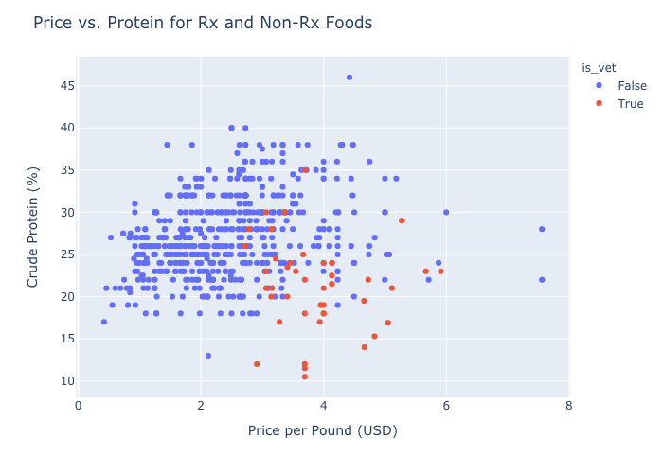
Exclusions
Veterinary/prescription diets
Only list calories per volume rather than by weight
Were missing any one or more of the above variables

Slide 10
Methodology Example : Crude Protein %
H_{o} : higher-protein food prices drawn from same distribution as lower-protein food prices
H_{a} : they are not
Calculated the median crude protein percentage: 26%
Divided 580 foods into two groups :
>= 26% higher-protein group
< 26% lower-protein group
Compared distributions of price-per-pound for each group
tested for normality (all were non-normal)
performed appropriate comparative test (Mann-Whitney U-test)
Performed correction for multiple tests (Bonferroni)
Repeat these steps for all other variables…
Notes:
Note, LID and grain-free diets were categorical, so did not require median value calculation.

Slide 11
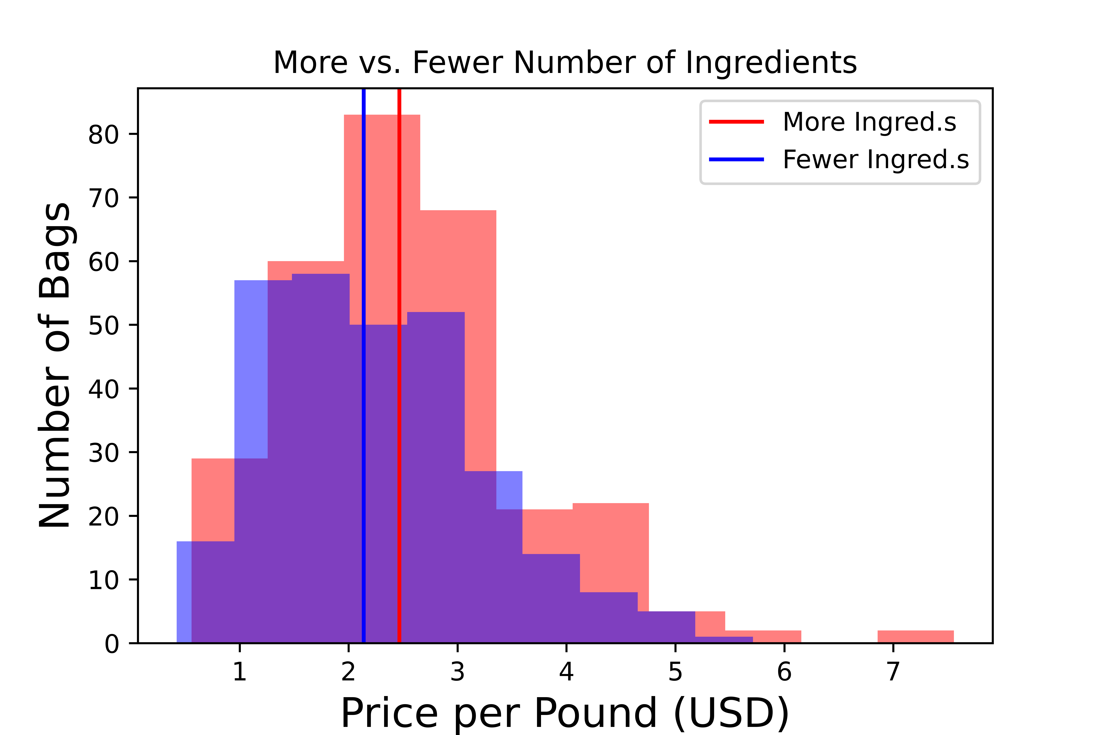
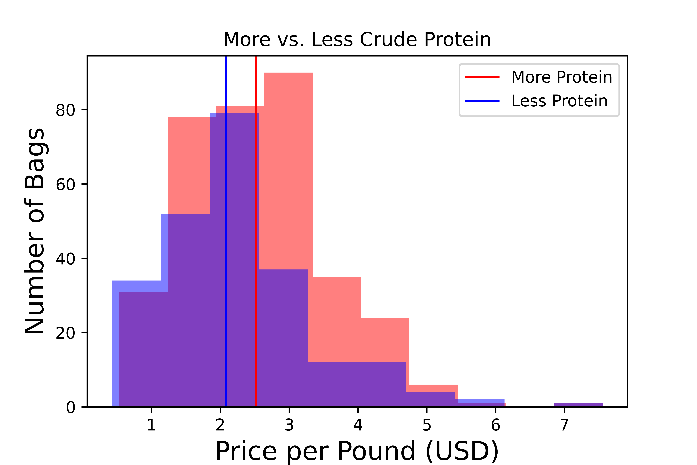
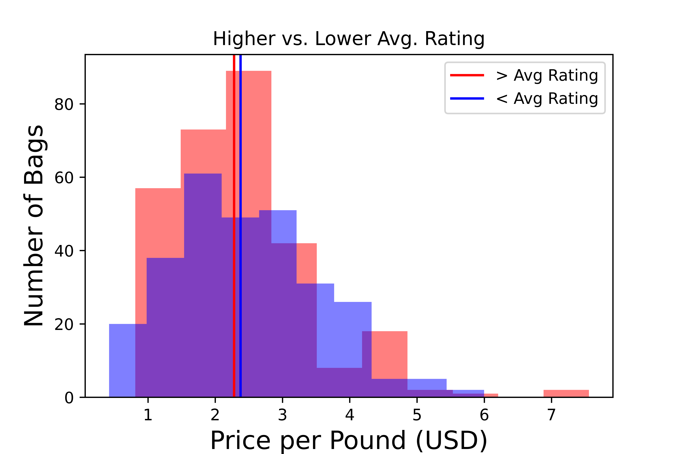
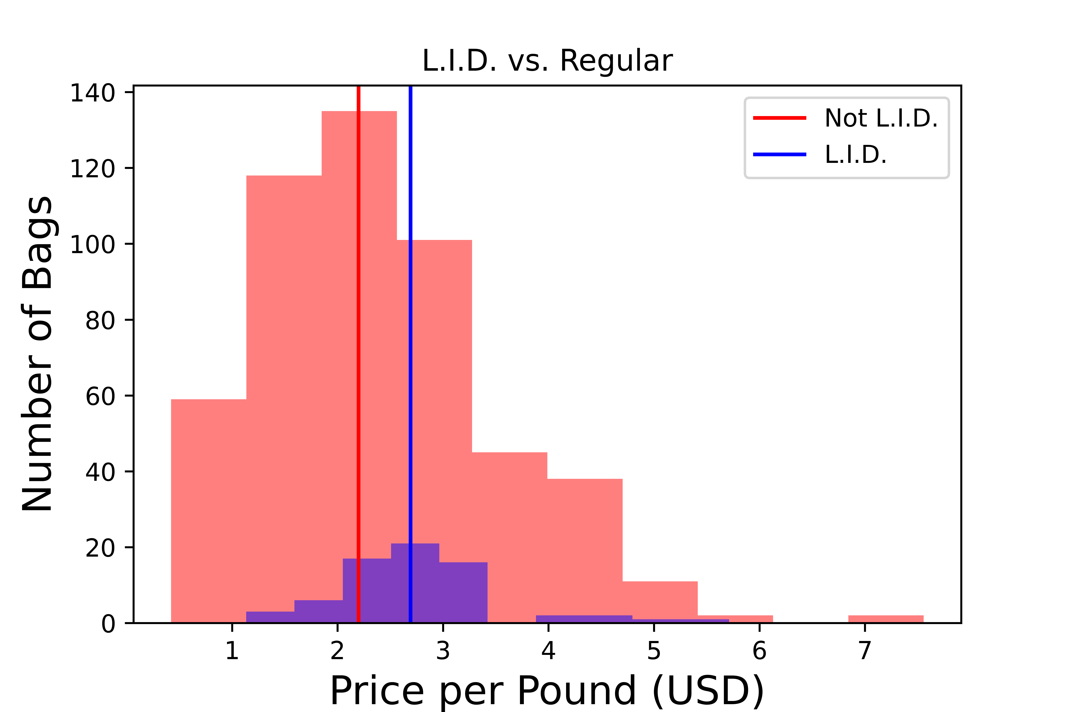
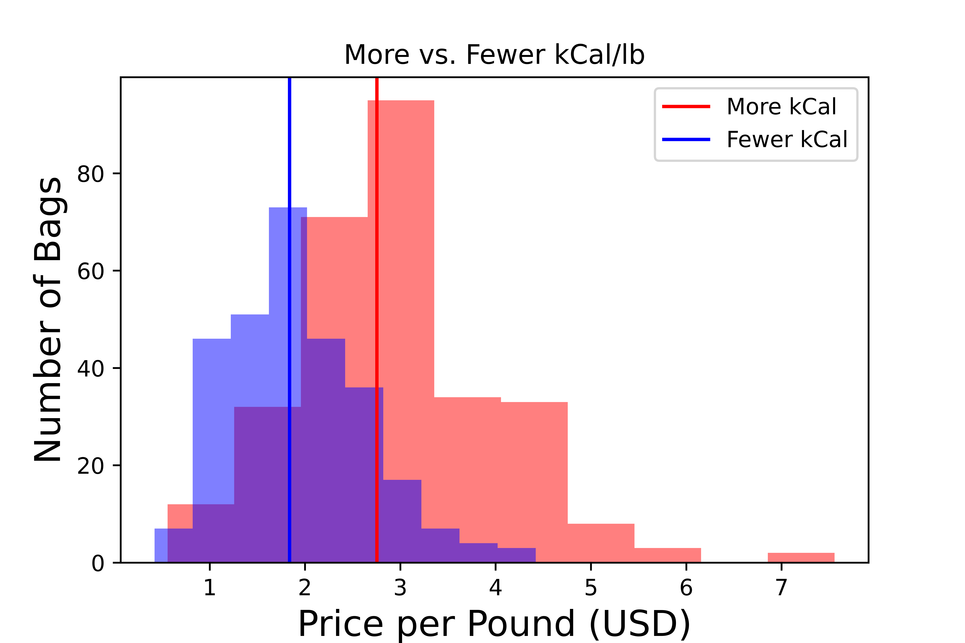
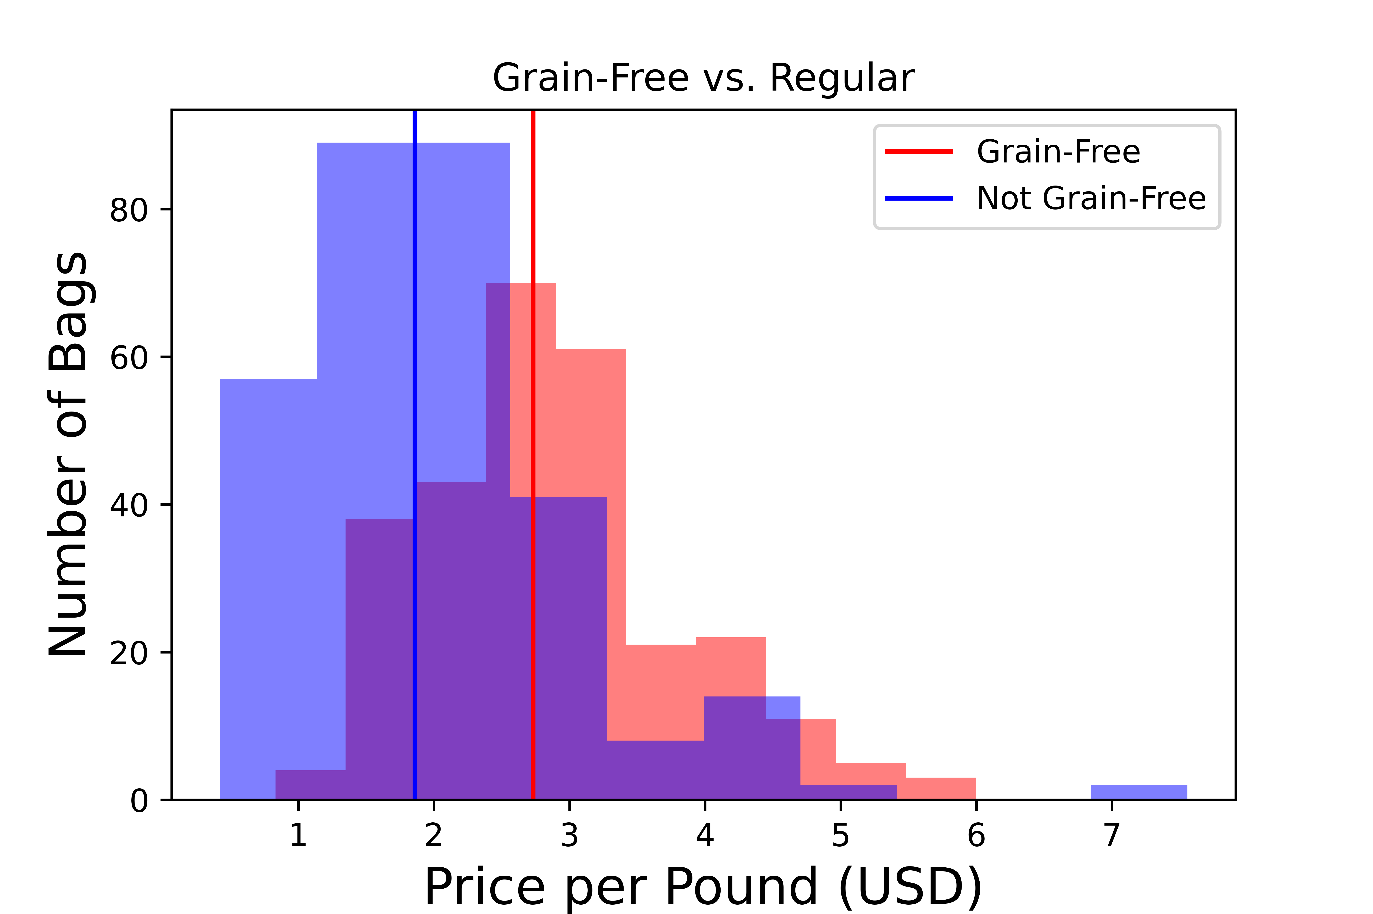
Notes:
Vertical lines represent median values of the distirbutions. We reject the null hypothesis for all variables except average user rating (p < 0.01)

Slide 12
Takeaways
Pricing is statistically different for high/low protein, high/low caloric density, high/low number of ingredients, LID vs. regular, and grain-free vs. regular
Pricing not statistically different for high/low average reviewer rating.

Slide 13
Limitations
Crude protein vs. true protein
Pricing not corrected for special promotions, all quantities available
Pricing does not necessarily reflect value!
Digestibility/bioavailability and quality of ingredients not listed on bag
Manufacturing practices, formula testing frequency, full time nutritionist on staff
Consult a vet nutritionist when choosing food!
https://vetnutrition.tufts.edu/2016/06/why-you-shouldnt-judge-a-pet-food-by-its-ingredient-list/
Notes:
A study of price versus digestibility: https://www.ncbi.nlm.nih.gov/pmc/articles/PMC4473150/

Slide 14
Future Work
Perform regression analysis to see magnitude of effects and tease out relationships between variables.
Test more variables: manufacturing location, life stage, breed size, other nutrient content, etc.
Wet dog food? Cat food? Other pet supply companies?

Slide 15

Questions?

